Slide 1

Project Title
SOA Project Review-1
Date& Time
 | Under the Guidance of Dr.Venkateswari Ketineni Department of Computer Science and Engineering, KLH CSE Bowrampet Campus
Team Members P Hansini – 2420030239 G Sreevarsha – 2420030241 Mani Charan Chava - 2420030545

Slide 2
Problem Statement
The AI-Powered Mutual Fund Portfolio Analysis and Investment Tracking System is designed to help users monitor and understand their mutual fund investments. The system tracks the user's investments, analyzes portfolio performance, evaluates the level of risk and diversification, and provides useful insights using historical mutual fund data and machine learning techniques. It helps users easily identify whether their portfolio is performing well and understand the risk associated with their investments.

Slide 3
Objectives
To collect and preprocess mutual fund, NAV, market, user holding, and SIP transaction data for accurate analysis.
To extract important financial features such as returns, volatility, risk, Sharpe ratio, expense ratio, and asset allocation.
To track user investments including SIPs, buy/sell transactions, units held, current NAV, portfolio value, and profit/loss.
To provide an interactive dashboard for viewing portfolio overview, returns, risk analysis, fund comparison, and historical trends.
To analyze mutual fund performance and provide fund ranking and comparison based on historical data.

Slide 4
Literature Survey
Authors | Title of the Paper | Methodology | Inferences | Limitation/Future work
S. R. Das & R. K. Jain | Mutual Fund Performance: A Synthesis of Taxonomic and Methodological Issues | Classified mutual funds and analyzed returns, fund flows, and performance using different evaluation methods. | Fund category, returns, investor flows, and risk-adjusted performance are important for portfolio evaluation. | The study covers broad methodological issues; a practical software-based portfolio system can integrate these analyses.
Nima Vafai & David Rakowski | The Sources of Portfolio Volatility and Mutual Fund Performance | Analyzed portfolio volatility using security-level variances and covariances. | Portfolio volatility depends significantly on the relationships between securities within the portfolio. | Analysis can be extended to different markets and practical investor portfolio applications.
S. R. S. Prasad et al. | A Critical Analysis of Selected Mutual Funds in India | Analyzed daily NAV data using statistical performance measures. | Mutual funds can be evaluated by comparing their historical NAV and performance measures. | Study focused on selected funds; future work can include more fund categories and larger datasets.

Slide 5
Problem Gap Identification
Limited integrated portfolio analysis
Difficulty identifying underperforming funds
Limited risk and diversification analysis
Lack of benchmark-based performance comparison
Limited modular/scalable architecture
Need for centralized investment tracking and analysis

Slide 6
Innovation, Creativity, and Novelty
Microservices-based architecture — separates the system into independent services such as User, Fund, Portfolio, Analysis, and Notification services.
Real-time portfolio insights — provides updated portfolio value, profit/loss, NAV, and performance information.
API-based service communication — services communicate through REST APIs, demonstrating SOA principles.

Slide 7
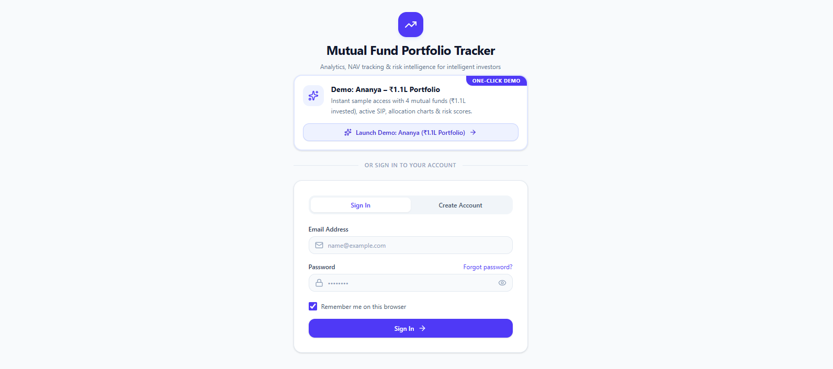

Slide 8
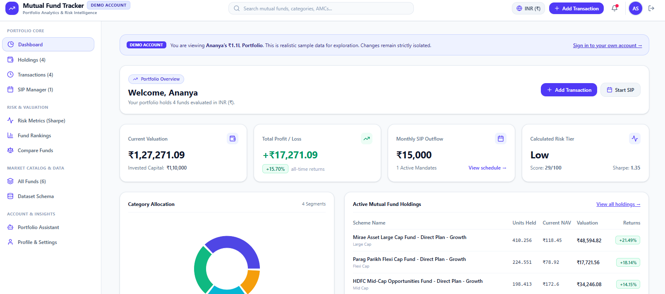

Slide 9
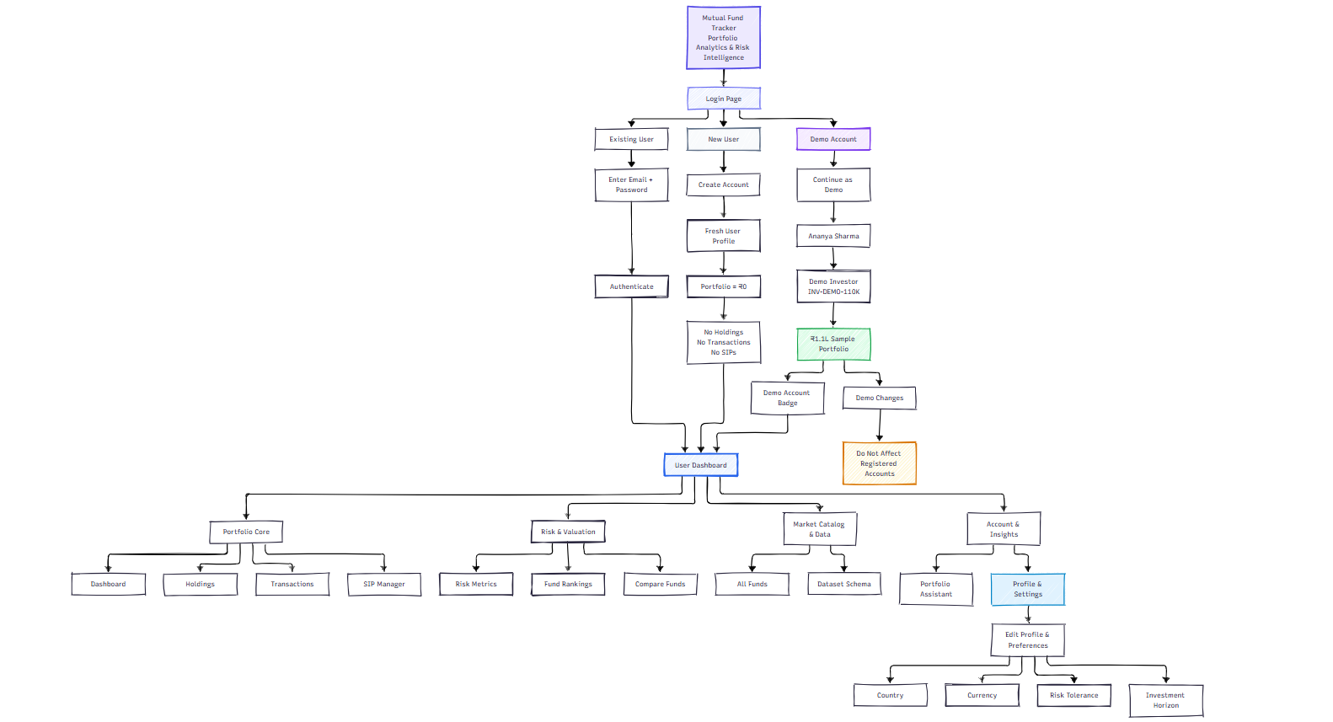
System Architecture

Slide 10
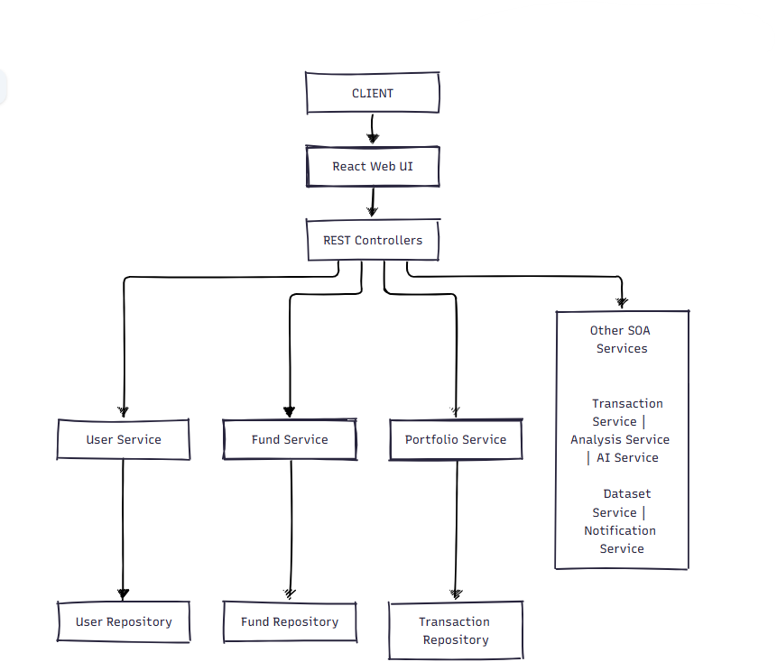
SOA Architecture

Slide 11
Methodology
Requirement Analysis – Identify requirements for portfolio tracking, mutual fund management, SIPs, transactions, analytics, and AI assistance.
SOA Architecture Design – Divide the system into independent services such as User, Mutual Fund, Portfolio, Transaction, Analysis, AI, and Notification services.
Database & Backend Development – Design the database entities and develop REST APIs using Java, Spring Boot, JPA, and H2.
Frontend Development – Develop an interactive web interface using React, Vite, Tailwind CSS, and Recharts for portfolio management and visualization.
Financial Analysis & AI Integration – Calculate portfolio returns, risk, diversification, and performance, and use AI to generate personalized portfolio insights and recommendations.
Testing & System Demonstration – Test all major functionalities, including authentication, transactions, SIPs, analytics, AI responses, and dataset processing, followed by complete system demonstration.

Slide 12
Feasibility and Project Plan
Technical: Java, Spring Boot, REST APIs, MySQL, and React are available and suitable for the project.
Operational: Users can easily track investments, view portfolio performance, and analyze risk through the system.
Economic: The project uses mostly open-source technologies and does not require specialized hardware.

